Slide 1
Electrodes Statistics

Slide 2
Bad Electrodes per Subject

Slide 3
Bad Electrodes Histogram

Slide 4
Histogram – per Subject

Slide 5
Bad Electrodes Histogram Potential Good Electrodes

Slide 6
Histogram – per Subject Potential Good Electrodes

Slide 7
Confusion Matrix

Slide 8
All healthy subjects All stimulation PCA

Slide 9
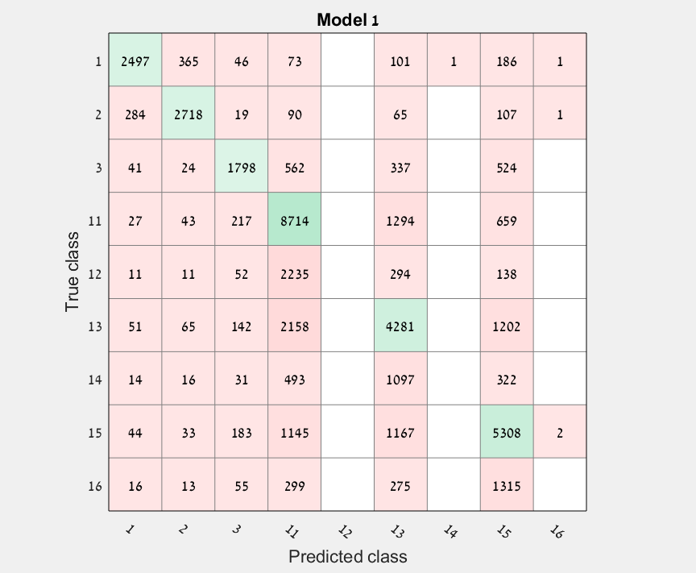
All healthy subjects All stimulation Gaussian SVM – confusion matrix

Slide 10
Parallel Transport

Slide 11
Subjects 1,2,3 Stimulation 1,2,3 PCA before parallel transport kernel matrices

Slide 12
Subjects 1,2,3 Stimulation 1,2,3 PCA after parallel transport kernel matrices
Pmean is mean of all riemannian means

Slide 13
Subjects 1,2,3 Stimulation 1,2,3 PCA before parallel transport covariance matrices

Slide 14
Subjects 1,2,3 Stimulation 1,2,3 PCA after parallel transport covariance matrices
Pmean is mean of all riemannian means

Slide 15
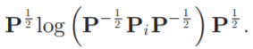
Subjects 1,2 All Stimulations PCA before parallel transport covariance matrices
*Before changing back the formula

Slide 16
Subjects 1,2 All Stimulations PCA after parallel transport covariance matrices

Slide 17
Subjects 6,12 Stimulation 3,13,15 PCA before parallel transport covariance matrices

Slide 18
Subjects 6,12 Stimulation 3,13,15 PCA after parallel transport covariance matrices
Pmean is mean of all riemannian means

Slide 19
Subjects 6,12 Stimulation 3,13,15 PCA after parallel transport covariance matrices
Pmean is riemannian means of first subject

Slide 20
Subjects 2,5,10 Stimulation 1,3,14 PCA before parallel transport covariance matrices
Code | system | details
1 | Somatosensory | right arm
3 | Visual | light flash
14 | Auditory | Subject own name

Slide 21
Subjects 2,5,10 Stimulation 1,3,14 PCA after parallel transport covariance matrices

Slide 22
Subjects 2,5,10 Stimulation 1,3,14 Diffusion maps before parallel transport covariance matrices

Slide 23
Subjects 2,5,10 Stimulation 1,3,14 Diffusion maps after parallel transport covariance matrices

Slide 24
Subjects 2,5,10 Stimulation 1,3,14 PCA before parallel transport kernel matrices
Code | system | details
1 | Somatosensory | right arm
3 | Visual | light flash
14 | Auditory | Subject own name

Slide 25
Subjects 2,5,10 Stimulation 1,3,14 PCA after parallel transport kernel matrices

Slide 26
Subjects 2,5,10 Stimulation 1,3,14 Diffusion maps before parallel transport kernel matrices

Slide 27
Subjects 2,5,10 Stimulation 1,3,14 Diffusion maps after parallel transport kernel matrices

Slide 28
Subjects 2,5,10 Stimulation 13,14,15,16 PCA before parallel transport covariance matrices
Code | system | details
13 | Auditory | sham word 1
14 | Auditory | Subject own name
15 | Auditory | sham word
16 | Auditory | Sham word

Slide 29
Subjects 2,5,10 Stimulation 13,14,15,16 PCA after parallel transport covariance matrices

Slide 30
Sick 1,2 Stimulation 1,15 PCA before parallel transport covariance matrices

Slide 31
Sick 1,2 Stimulation 1,15 PCA after parallel transport covariance matrices

Slide 32
Sick 1,2 Stimulation 1,15 PCA after parallel transport kernel matrices

